Slide 1
IE 362 Lecture 2: Object-oriented paradigm and Software design
Il-Chul Moon
Department of Industrial and Systems Engineering
KAIST

Slide 2
A better way to develop software

Slide 3
Weekly Objectives
This week, we learn the object-oriented paradigm (OOP) and the basic of software design.
Objectives are
Understanding object-oriented concepts
Class, instance, inheritance, encapsulation, polymorphism…
Understanding a formal representation of software design
Memorizing a number of Unified Modeling Language (UML) notations
Understanding a number of software design patterns
Factory, Adapter, Bridge, Composite, Observer
Memorizing their semantics and structures

Slide 4
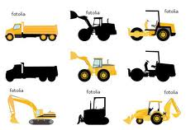
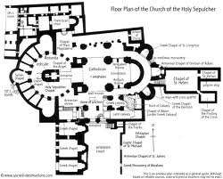



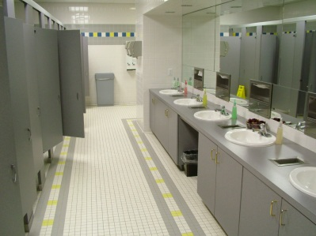
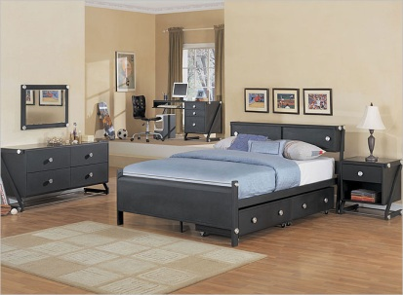
Design and Programming
Software Design
Software Implementation
Development
Matlab
Lobby 1
Lobby 2
Restroom
Bedroom
Same
Same Role, Similar Design, and Different Interior

Slide 5
Good Software Design
Good or Bad Design?
 | Building Design | Software Design
Correctness | Meet the owner’s purpose Successful construction without faults | Meet the client’s purposes Successful implementation without errors
Robustness | Maintain integrity in a certain level of typhoons | Execute under expected overloads
Flexibility | Enable the future expansions and modifications of the structure | Enable the future updates and expansions of functions
Usability and Reusability | Good support for designed purposes Easy to use for 1) other purposes and 2) other areas | Good support for the designed Easy to use for 1) other purposes and 2) other contexts
Efficiency | Easy to build Cover less area Good mobility in the structure | Easy to implement Smaller size Faster execution

Slide 6
Approaches to Handle Complexities
Software and building are complex! Why?
Often, they tend to be
Massive in size
Interactive between modules
No-where to stop in details and scopes
How to make things less complex
Boundarize
You have to setup your boundary by your purpose
Simplification/Abstraction
You have to simplify your structure at the top level
Decomposition
You have to construct a hierarchy of your structure, so that you can delegate your problem to your minions.
Grouping
You have to cluster similar structures to use “Copy, Adapt and Paste” (No Copy and Paste)
Magical number 7±2
G.A. Miller, “The Magical Number Seven, Plus or Minus Two: Some Limits on Our Capacity for Processing Information”, The Psychological Review, 1956, vol. 63, pp. 81-97 (http://www.well.com/user/smalin/miller.html)
Catch phrase is “Divide and Conquer”

Slide 7
Procedure-Oriented Paradigm
Boundarize, Simplify, Decompose, and Group What?
Two views
Object oriented view: Building structure / Software structure
Procedure oriented view: Building usage / Software usage
Procedure-oriented view
70s and 80s
Boundarize, simplify, decompose, and group
Building: A in his office uses a restroom
A goes out his office → A walks down the corridor → A enters the restroom → A uses a toilet
Software: A withdraw money from his account by a banking website
A logs in a banking website → A confirms his ID → A requests his withdrawal
Action oriented and Verb oriented
Design actions, or functions
Implement actions, or functions
Objects are just data
Objects are
(A, Corridor, Restroom, and Toilet)
(A, banking website, ID, and withdrawal)

Slide 8

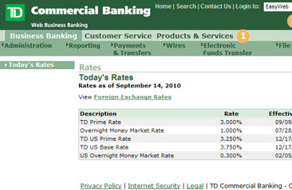
Procedure-Oriented Design
Real world concepts
Software
design
entities
logIn()
checkSecurityCard()
selectAccount()
sendMoneyRelease()
reduceAccountAmount()
sendNotice()

Slide 9
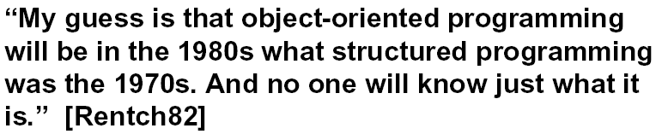
Object-oriented paradigm
Object-oriented view
80s, 90s, and 00s
Boundarize, simplify, decompose, and group
Building: A in his office uses a restroom
A goes out his office → A walks down the corridor → A enters the restroom → A uses a toilet
Software: A withdraw money from his account by a banking website
A logs in a banking website → A confirms his ID → A requests his withdrawal
Object oriented and Noun oriented
Design actors, or objects
Implement actors, or objects
Actions are just methods of objects
(goes out, walks down, enters, uses)
(logs in, confirms, requests)
Object = (attributes, or characteristics) + (methods, or actions)
Why? → More concerns about the domain, the users, and the actual things
Phases
Object-Oriented Analysis
Define an object-based model of the domain
Object-Oriented Design
Design the solution
Object-Oriented Programming
Build it : coding
Object-Oriented Testing
OOAD
OOSE

Slide 10
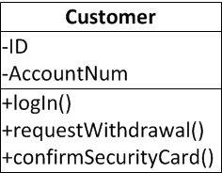
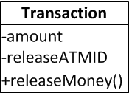
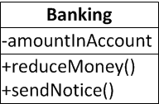
Object-Oriented Design
Real world concepts
Abstract
Abstract
Abstract
Software design entities

Slide 11







What are Class and Instance?
Class vs. Instance
Class
Result of design and implementation
Conceptualization
Corresponds to design abstractions
Instance
Result of execution
Realization
Corresponds to real world entities
ID: John Acct #: 123
ID: Park Acct #: 456
ID: Kim Acct #: 789
ID: Koh Acct #: 035

Slide 12
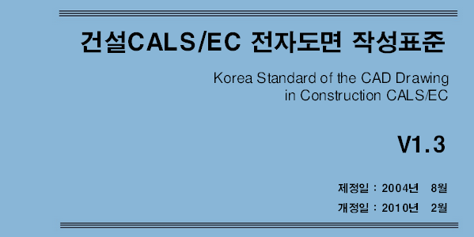
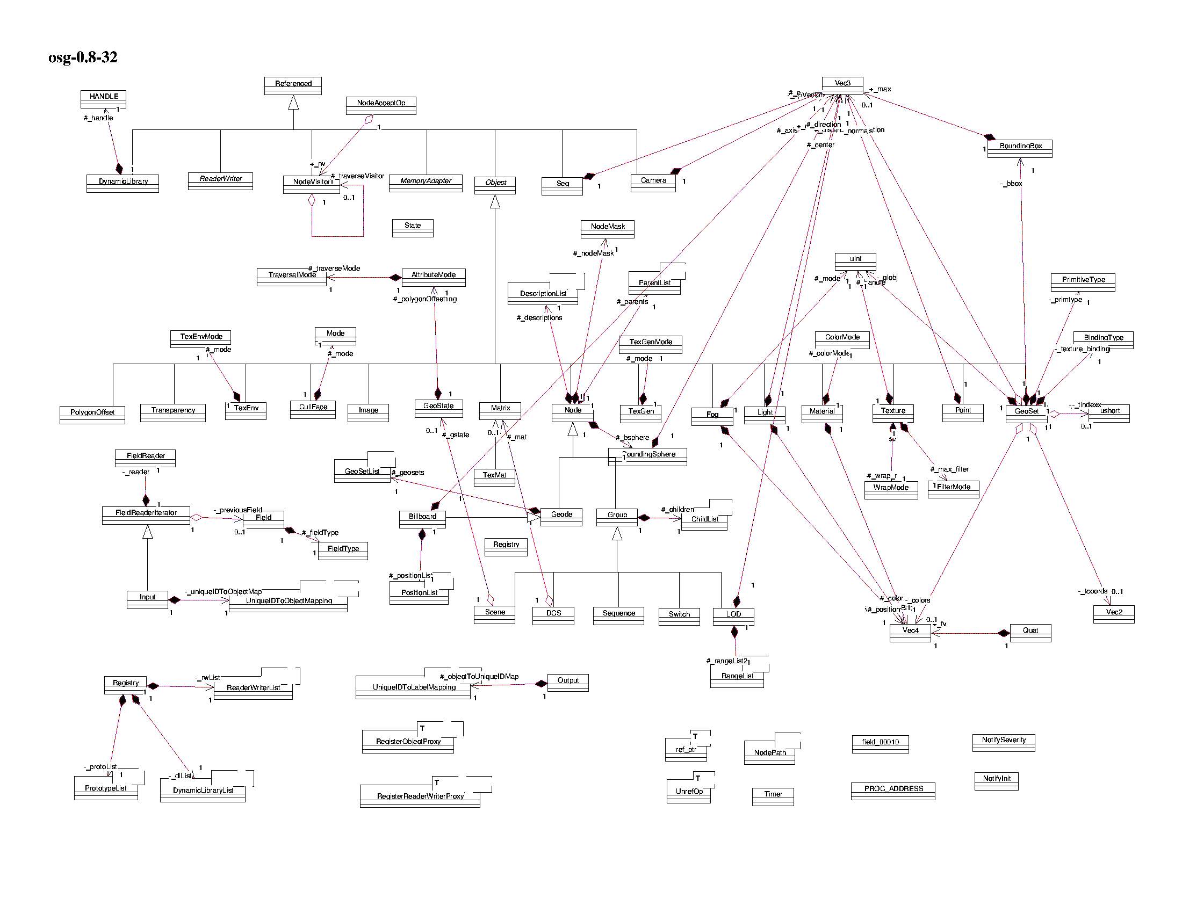

Software Design as House Floorplan
After your graduation, some of you will be constructors of software
Mainly design
Some coding
Need to learn how to communicate your colleagues
Learn standard
Learn how to represent your design to your boss
In software engineering,
UML is the standard

Slide 13
UML for software design

Slide 14
Software Design as House Floorplan
After your graduation, some of you will be constructors of software
Mainly design
Some coding
Need to learn how to communicate your colleagues
Learn standard
Learn how to represent your design to your boss
In software engineering,
UML is the standard

Slide 15
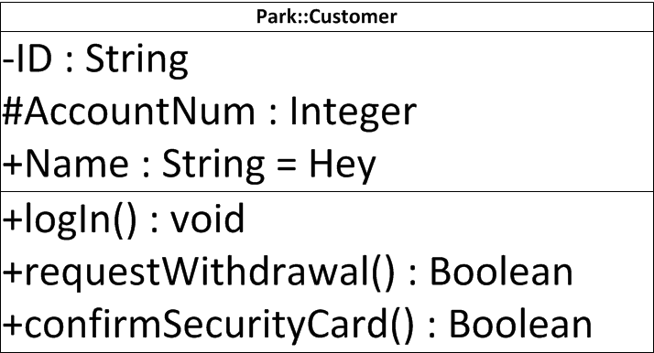
UML notation : Class and Instance
Abstract class
Class
Named instance
Unnamed instance
Person
Customer
Park::Customer
:Customer
Instance Name
Class Name
Member variables
+-#(name):(type)=(default value)
Visibility options
+ → public
# → protected
- → private
Methods
+-#(name)(arguments):(type)

Slide 16
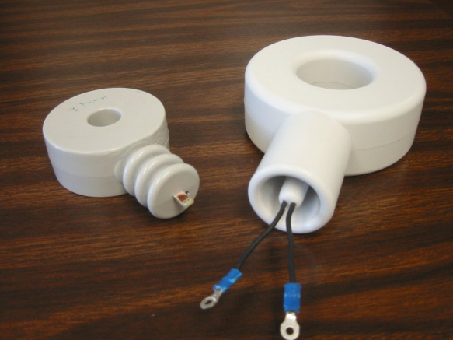
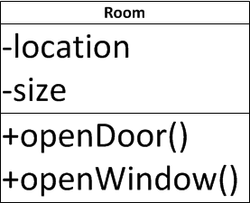


Encapsulation
Object = Data + Behavior
Data : field, member variable, attribute
Behavior : method, member function, operation
Delegating the implementation responsibility!
Bring me a sausage, and I don’t care how you made it
Utilizing the visibility
private: seen only within the class
protected: seen only within the class and its descendants
public: seen everywhere
Building Architecture
I care overall composition
Interior Designer
I care inside implementation
Class Definition
Interface as a specification

Slide 17

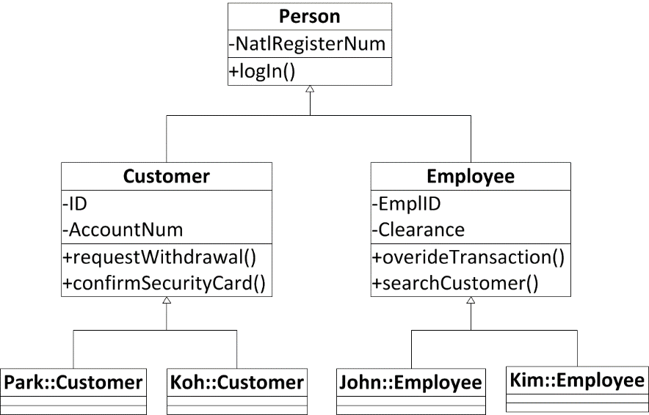
Inheritance
Inheritance
Giving my attributes to my descendants
My attributes include
Member variables
Methods
My descendants may have new attributes of their own
My descendants may mask the received attributes
But, if not specified, sons follow their father
Superclass
My ancestors, specifically my father
Generalized from the conceptual view
Subclass
My descendants, specifically my son
Specialized from the conceptual view
Generalized
Specialized

Slide 18
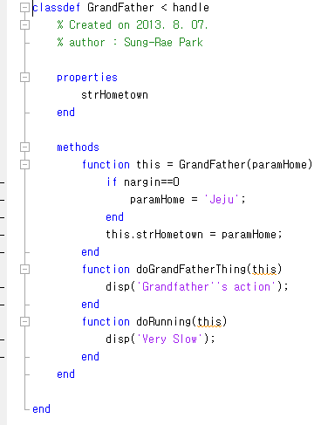
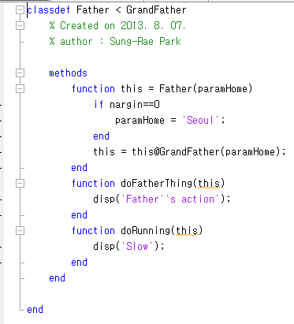
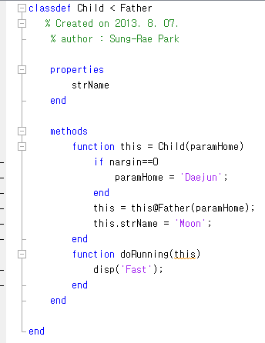
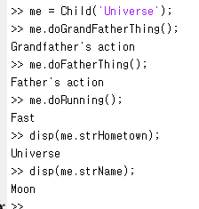
Inheritance in Matlab
Base Class
(Super class)
See Child has Father’s attribute
See Child overwrite Father’s method by his own

Slide 19
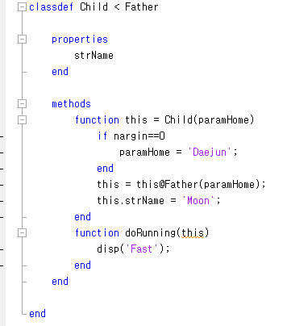
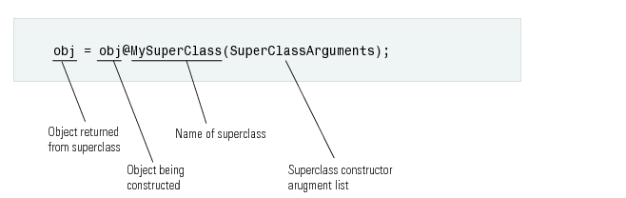
self and super
Referring Father to point Father’s constructor
self : reference variable pointing the instance itself
In this case, “this” is the return of the created instance
super : reference variable pointing the base class instance
In this case, “@Father” indicates the superclass to be called.
Referring itself to point its attributes

Slide 20


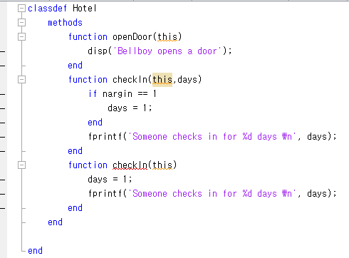
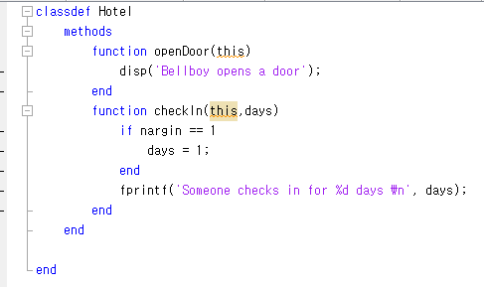
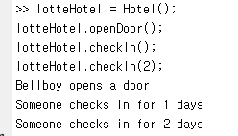
Polymorphism
Light Morph
Black Morph
Polymorphism
Poly: Many
Morph: Shape
Different behaviors with similar signature
Signature = Method name + Parameter list
Method Overriding
Base class has a method A(num), and its derived class has a method A(num)
Method Overloading
A class has a method A(num), A(num, name), and A(num, name, home)

Slide 21
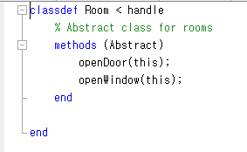
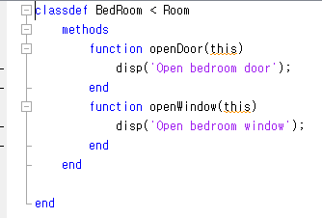
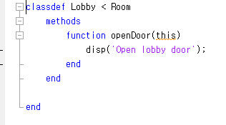
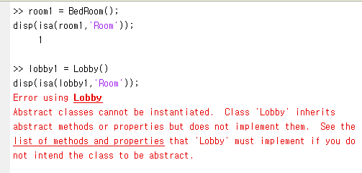
Abstract Class
Indicator of abstract base method and class
Abstract class, or Abstract Base Class in Matlab
A class with an abstract method
What is the abstract method?
Method with signature, but with no implementation
Why use it then?
I want to have a window here, but I don’t know how it will look like, but you should have a window here!
Abstract class is not a complete implementation, it is more like a half-made produce
Therefore, you can’t make an instance out of it
The concrete class with full implementations and inheriting the abstract class will be a basis for instances

Slide 22
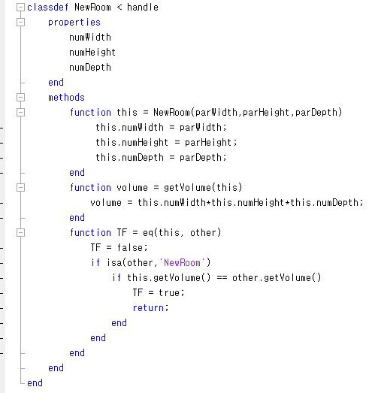
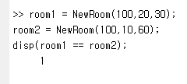
Overriding Methods in handle
All reference classes in Matlab are the descendants of handle
You have to specify that you inherit handle with “< handle”
handle has many hidden methods
eq
gt
lt
ne
delete…
You override them to make the methods behave as you please
Duck Typing
Easier to Ask for Forgiveness then Permission (EAFP)

Slide 23
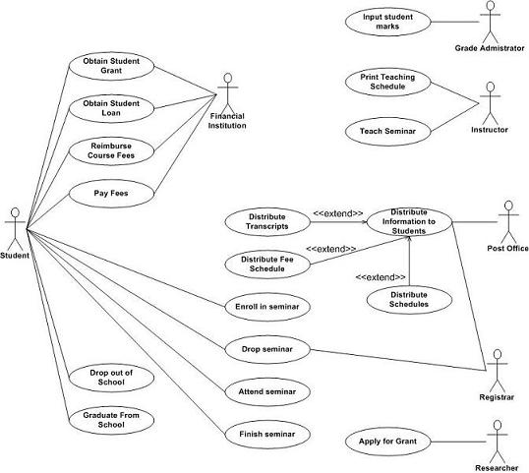
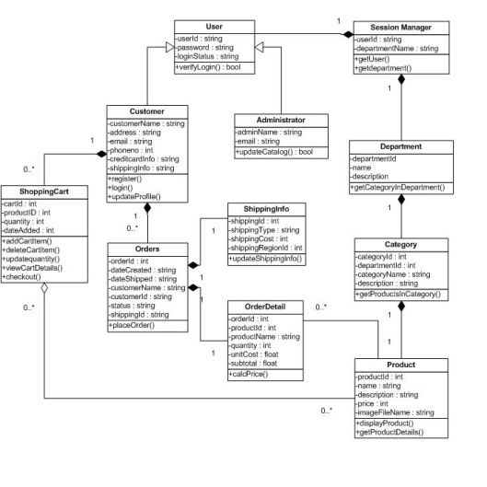
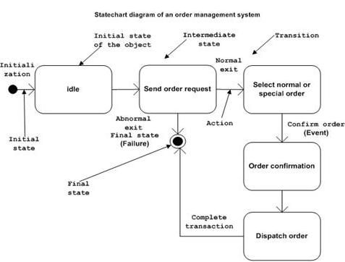
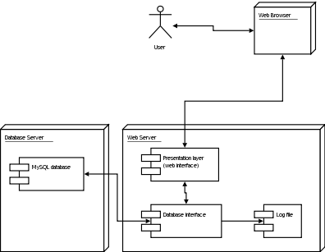
More about UML Notations
Many types of UML diagrams used for different stages of development. If I name a few of them…
Use-case diagram
Class diagram
State diagram
Deployment diagram
We are dealing with OOP in this week
Mainly, class and instances
Also, some of software design patterns
Hence, we focus on
Class diagram

Slide 24
UML notation : Class and Instance (one more time)
Abstract class
Class
Named instance
Unnamed instance
Person
Customer
Park::Customer
:Customer
Instance Name
Class Name
Member variables
+-#(name):(type)=(default value)
Visibility options
+ → public
# → protected
- → private
Methods
+-#(name)(arguments):(type)

Slide 25
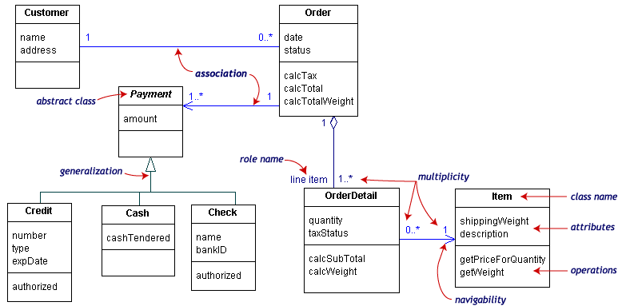
Structure of Classes in Class Diagram
Class Name
Entity
What makes a structure?
Entity and Relationship
Relationship and its characteristic

Slide 26

Generalization
Generalization between classes
is-a relationship
Inheritance relationship
Customer → Person
From subclass
To superclass
Direction of generalization
Hollow triangle shape
Base class
Person
Leaf class
Park::Customer…

Slide 27
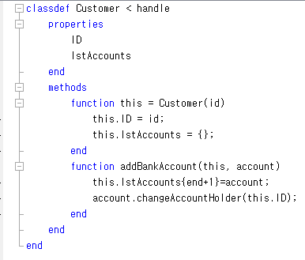
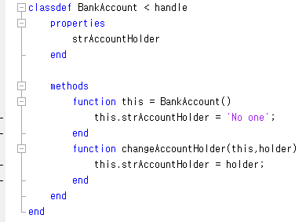
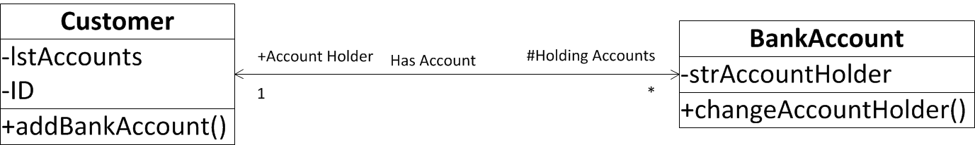
Association
Association between classes
has-a relationship
Member variables
A customer has a number of holding accounts
An account has an account holder customer
Simple line
If a simple arrow is added
A customer has a reference to bank accounts
A bank account has a reference to a customer
Navigability
Line ends are tagged by roles
Account holder
Holding accounts
With prefix showing the visibiliy
+: public , -: private, #: protected
Roles
Navigability
Name
Multiplicity

Slide 28
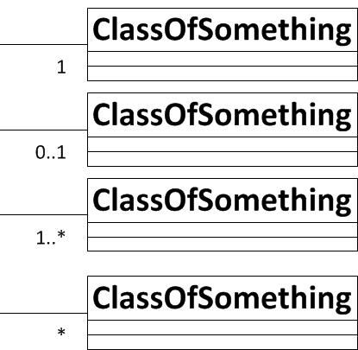
Multiplicity of Association
In computer science and engineering
* often means many
Hence,
1..*
1 to Many
*
0 to Many
Naturally
1
Exactly one
0..1
One or zero
If not specified, it means one

Slide 29

Aggregation
Special case of association
Special has-a relationship
More like, part-whole or part-of relationship
A family member is a part of a family
The existence of the family depends on the aggregation of the family member
If nothing to aggregate, there is no family
Hollow diamond shape
Aggregation often occur
when an aggregating class is a collection class
When the collection class’s life cycle depends on the collected classes

Slide 30
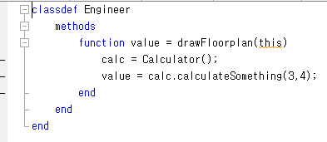
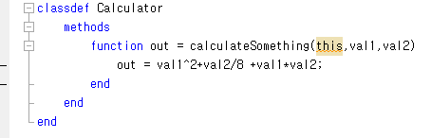

Dependency
Dependency between classes
use relationship
An engineer uses a calculator
May use for
Local variables
Method signatures
Parameter types
Method return types
Something that you import for the implementation

Slide 31
Let’s Practice

Slide 32
Software design patterns

Slide 33

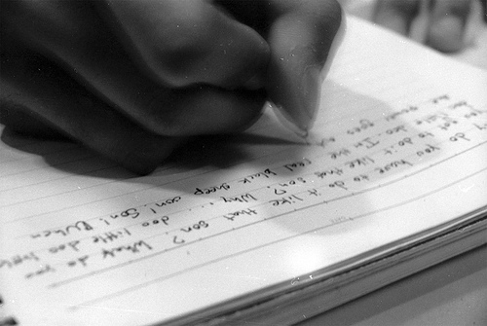
Design Patterns
What you have learned so far is
Reading the floorplan of your software
Limited to some notations in the floorplan
However, reading and writing are different
Reading a text in a foreign language
You can use a dictionary to find the meanings of words
You can guess what the words mean collectively
Writing a text in a foreign language
Still, you can use a dictionary to find the words that you want to use
But, you do not know how to lay down the words to make sense out of them
→ So what you need is a pattern of writing
Similarly, you need to learn the pattern of software design

Slide 34
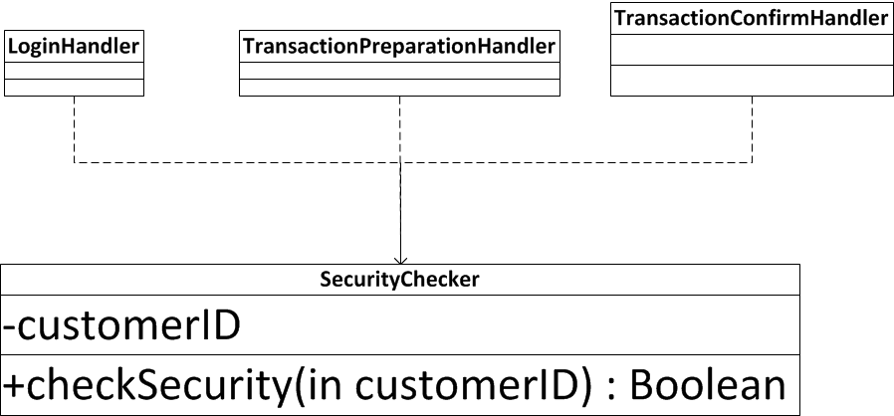
Factory Pattern (1)
A scenario of software requirements
A customer has a bank account
The customer uses a online banking service
To use service, the customer should go through the online security check
At three points: login, before transaction, and after transaction
It is better to make a SecurityChecker class
It is too much to put the security check in the Customer class
Use the SecurityChecker class at three required points

Slide 35
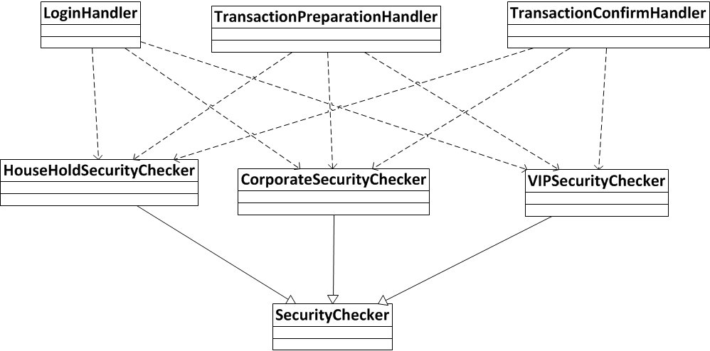
Factory Pattern (2)
Next day, the scenario extended
Each of customers belong to three groups exclusively.
Household Customer, Corporate Customer, VIP Customer
The three groups have different security check rules, so implementation should be different

Slide 36
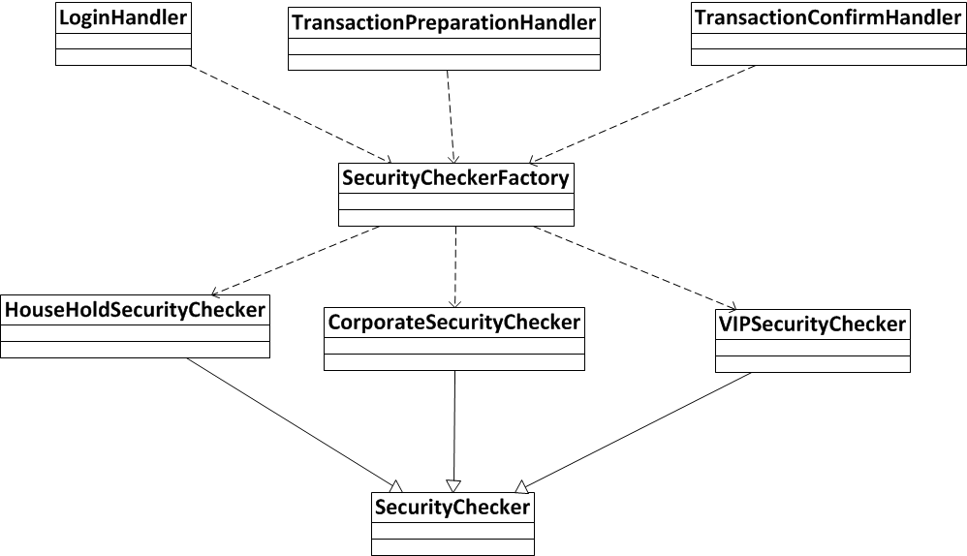
Factory Pattern (3)
Because of busy dependencies, Factory pattern jumps-in
Factory Pattern
Take charge of creating instances
Return the created instances by its base class type

Slide 37
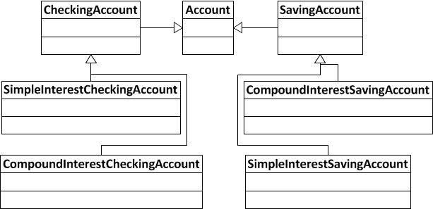
Bridge Pattern (1)
A scenario of software requirements
Bank has diverse types of bank accounts
Types are categorized
Usage: Checking account, Saving account
Interest: Simple interest, Compound interest
Your obvious design choice
Create four leaf classes in a hierarchy
Cost three additional abstract classes

Slide 38
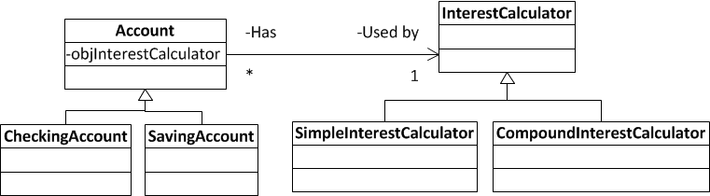
Bridge Pattern (2)
Bridge pattern
Diving the main stream of hierarchy from the branches
This is about an account
So, the hierarchy should be related to the account types
Calculating interest is only one characteristic of an account
So, it means that the account has a behavior → Associate the behavior class

Slide 39
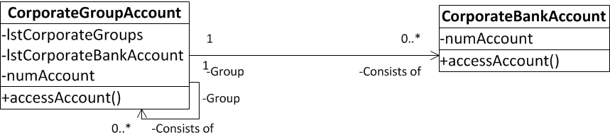
Composite Pattern (1)
The scenario of software requirements
Bank decided to establish a new type of customer groups
Corporate group account
A corporate group account is a set of a corporate bank account and a sub-corporate group account inside.
A sub-corporate group account acts just like a corporate group account
How to design the corporate group?
An obvious design is
CorporateGroupAccount class
CorporateBankAccount class
Corporate Group Accunt
Corporate Bank Account
Corporate Bank Account
Corporate Group Account
Corporate Bank Account
Corporate Bank Account

Slide 40
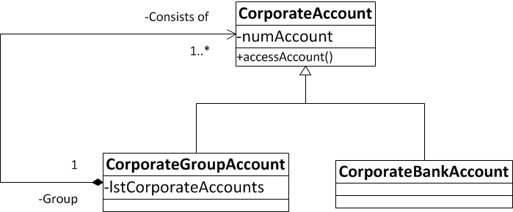
Composite Pattern (2)
We can do better than the obvious design
First, an abstract base class would be useful
Second, you can see the aggregate relations
Aggregation for container classes
However, aggregation happens at multiple levels → Key of the composite pattern
There is a minor detail in the diagram, can you find it?
Aggregation vs. Composition

Slide 41
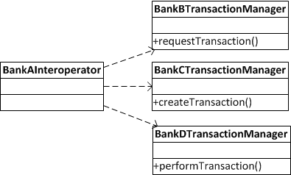
Adapter Pattern (1)
The scenario of software requirements
Your bank A is plan to interoperate with bank B, C, and D
Each bank has slightly different specifications of transactions
In your code, many times, You have to access bank B, C, and D
Obvious solution
Import classes from bank B, C, and D
Use if-then-else for a selective usage of the classes

Slide 42

Adapter Pattern (2)
Create an adapter class
Adapter class
Sorts out which goes to which
Inside of its methods determines which goes to which class
Delegation of the responsibility
Many developers for Bank A needs only TransactionAdapter class
Few developers will develop the adapter because it is only a wiring job
Two types of adapter
Object level
This case
Class level
Further study

Slide 43
Further readings
UML in a Nutshell
pp. 15-64, 75-81, 139-158
패턴 그리고 객체지향적 코딩의 법칙
pp. 15-24, 51-61, 121-122, 126-136, 214-231, 258-268
Design Patterns, elements of reusable object-oriented software
pp. 87-96, 139-174

